Slide 1
Production Introducing of HIVISION
P3.91 Indoor LED Display

Slide 2
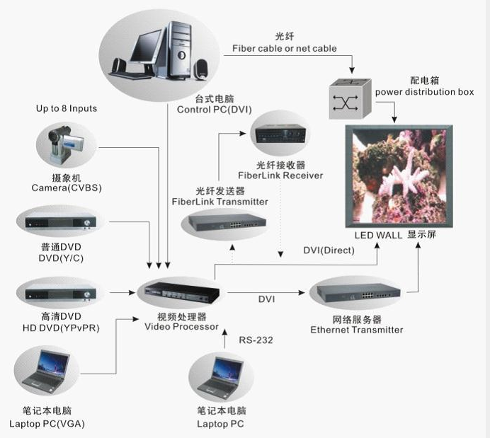
System Connection Drawing

Slide 3
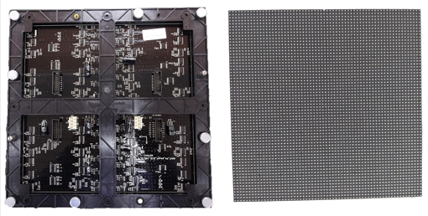
LED Module Parameter:
Dimensions (w x h) | 250mmx250mm | Resolution (w x h) | 64 x 64
Pixel Pitch (mm) | 3.91mm | Pixel Density | 65536/㎡
Average Power/Module | 12watts | Weight | 0.8kg
Pixel Configuration | RGB 3-in-1

Slide 4
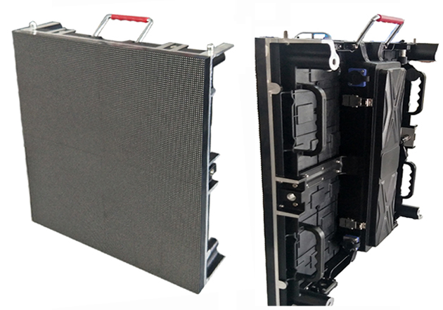
LED Cabinet Parameter
Dimensions (W x H x D) | 500mmx500mmx90mm | Module Quantity | 4 pcs
Physical Resolution (W x H) | 128 x 128 | Physical Pixels (total) | 16384
Weight/Cabinet | 7 kg | Material | Aluminum Die Cast
Average Power/ ㎡ | 190watts | Max Power/ ㎡ | 540watts

Slide 5
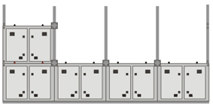
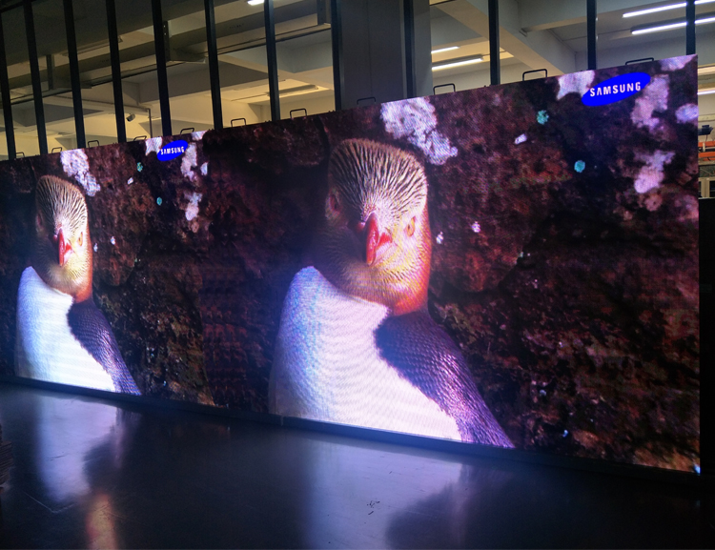
Solution Details

Slide 6
Led Display Parameter
Parameter | Value
Brightness (calibrating value) | 1500 nits
View Angle (min, 50% brightness) | Horizontal ≥ 150 deg. Vertical ≥ 150 deg.
Recommended Min. Viewing Distance | 3 meters
Brightness Control | 100 levels
Digital Processing | 16 bits
Display Color | 281 trillions
Refresh Rate (PAL/NTSC) minimum | >2400 Hertz
Drive Type | Constant current drive
Scan Type | 1/16

Slide 7
Input Voltage | AC220V/50Hertz or AC110V/60Hertz
Color Temperature | 6500 deg. k
MTBF | >10,000 hours
Life Span( 50% Brightness) | >100,000 hours
Module Brightness Uniformity | <5%
Operating Temperature Range | -20 to +50 deg. C
Operating Humidity Range | operating 10~99%
Display Input Format (with Video Processor) | VGA, DVI, RGBHV, PbPr(HDTV), Composite, S-Video, TV
System Operation Platform | WINDOWS(WIN98、WINXP、WIN2000)

Slide 8
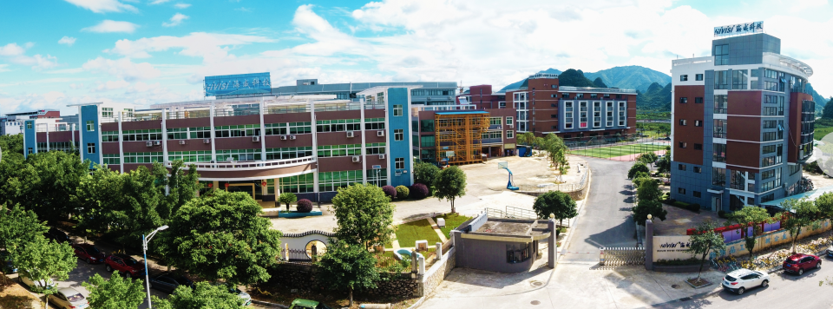
Welcome to visit us in Guilin, China!
Contact: Lily Liao
Mobil: +86-13977388757
Email: lilyliao@hivision.com.cn
Address: No. 12, Chao Yang Road, National Information & Technology Park，Guilin, Guangxi 541004, China

