Slide 1
5 IN 1 Jump starter
AC 110V/220 Outlet.
Jump start up to 8.0L Gas & 6.0L Diesel engine.
Power bank fast charge for your USB devices.
Spot light.
Hazard light.

Slide 2
Source of inspiration

Slide 3
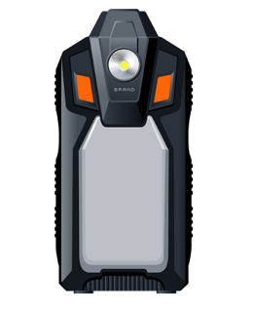
Functional indicators: CJS51
1. Features: 5 IN 1 Jump starter
2. Capacity: 16000mAh
3. Specifications: 2 USB ports+AC Output
-Type C Input: QC18W
-USB Output 1&2: (QC3.0) 5V/3A, 9V/2A, 12V/1.5A
-AC Output: 110V/60HZ, 220V/50HZ
-Rate Power: 100W (Max 120W)
4. Start the car: 12V
5. Start Current: 600A
6. Peak Current: 1200A
7. LED Flashlight: High Brightness/Medium Brightness/Front Light/Red Warning/Strobe Red.
8. Dimension: 125*265*170mm
9. Product weight: ≈ 900g
10. Cycle times (life) : 1000 times
11. Charge time: 250-400 minutes
12. Battery Cells type: 4pcs 6272100
13. Material: PC+ABS/V0&TPU
14. Working temperature: -20℃-60℃
Accessories & Packaging requirements:
1. A USB C cable
2. An Intelligent Clamp
3. Manual
4. Box Package

Slide 4
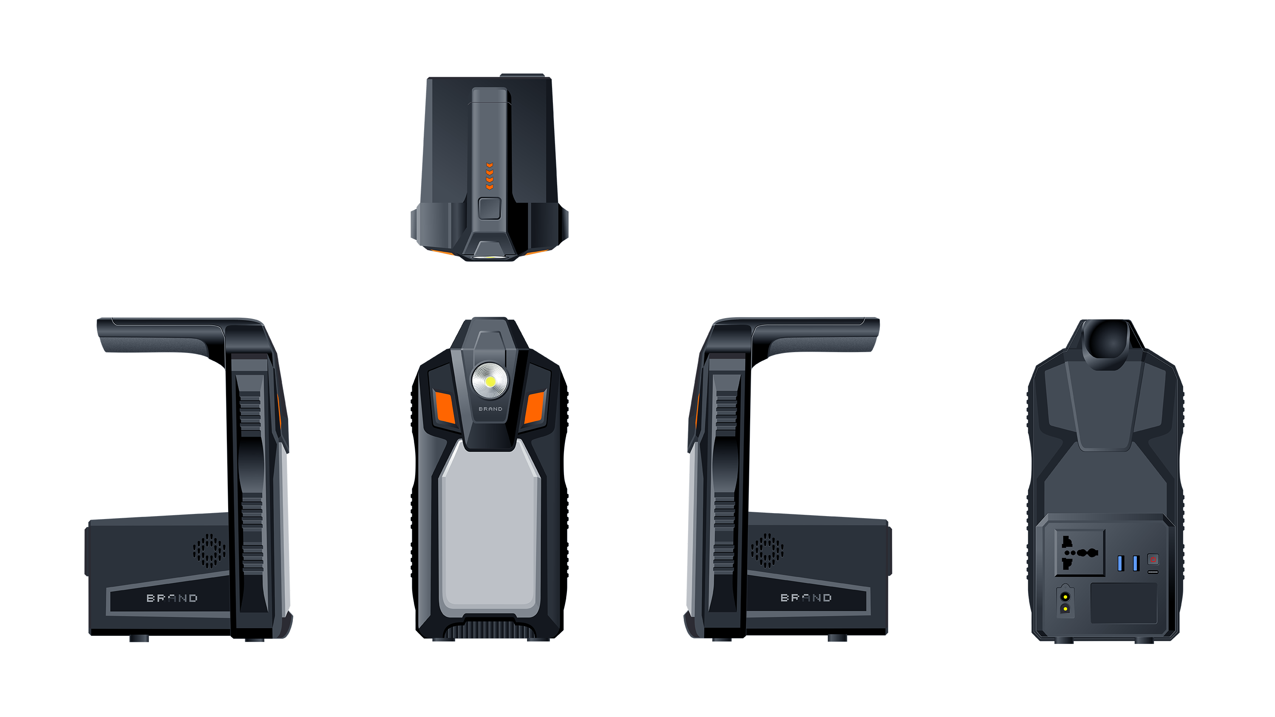
Dimension: 125*265*170mm

