Slide 1
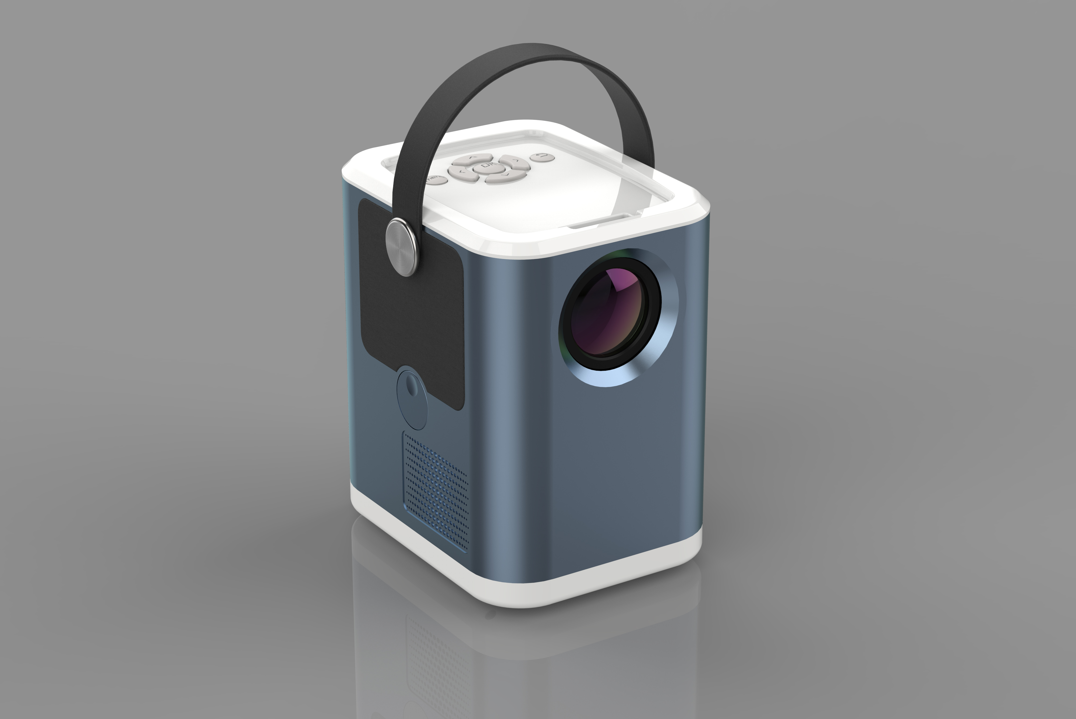
2020 New 4K Android9.0 Smart WiFi Projector BBQ4 1080P Full HD,4K@H.264,4K@H.265, 8K@24FPS Supported

Slide 2
BBQ4, A New Standard for Home Cinema Projector
Android 9.0 with 2G+32G
Quad Core CPU
Original Google Android TV OS； supports all programs in GOOGLE PLAY; YouTube, NETFLIX, and all other Apps.
Stereo Speaker System with 300cc Sound chamber and high-end DSP chipset.
Super high Brightness and Super low noise
Bluetooth Speaker Mode, for mobile phone music play.

Slide 3
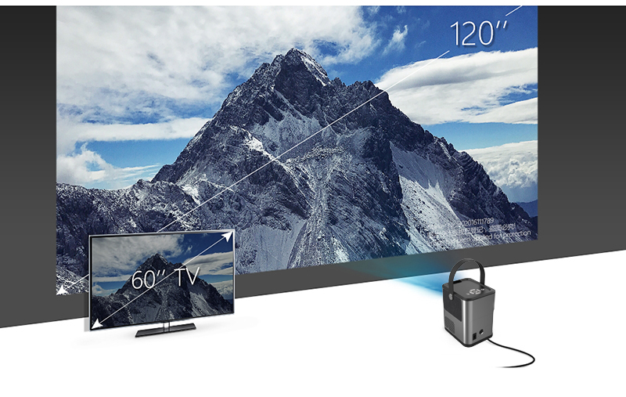
Enjoy up to 120 inch big screen with Projecor BBQ4 Cheaper than TV, but screen is much bigger.
Even to project a only 40” screen for office use;
(Projector BBQ projects 40inch screen at 1.3M)
120” huge screen for fantanstic home cinema.
(Projector BBQ projects 120inch screen at 4M)

Slide 4
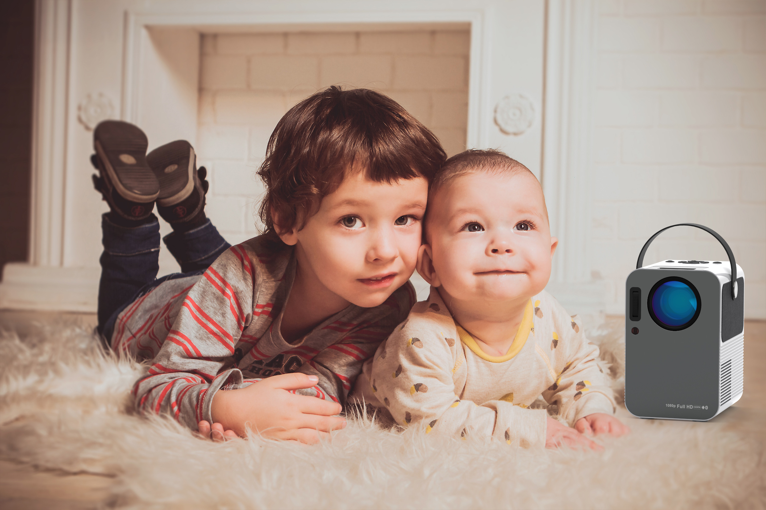
Watching TV drama/Cartoon & Playing online game with Projector BBQ4,no harm to eyes.
Really Low Noise with the help of the ever-big fans (7025) inside.

Slide 5
BBQ4, A Good Eye-protection Product for Kids.
85% uniformity, is outstanding among all other competitors, which is so wonderful on experience
110% NTSC color gamut, also an new record for projection bisiness.

Slide 6
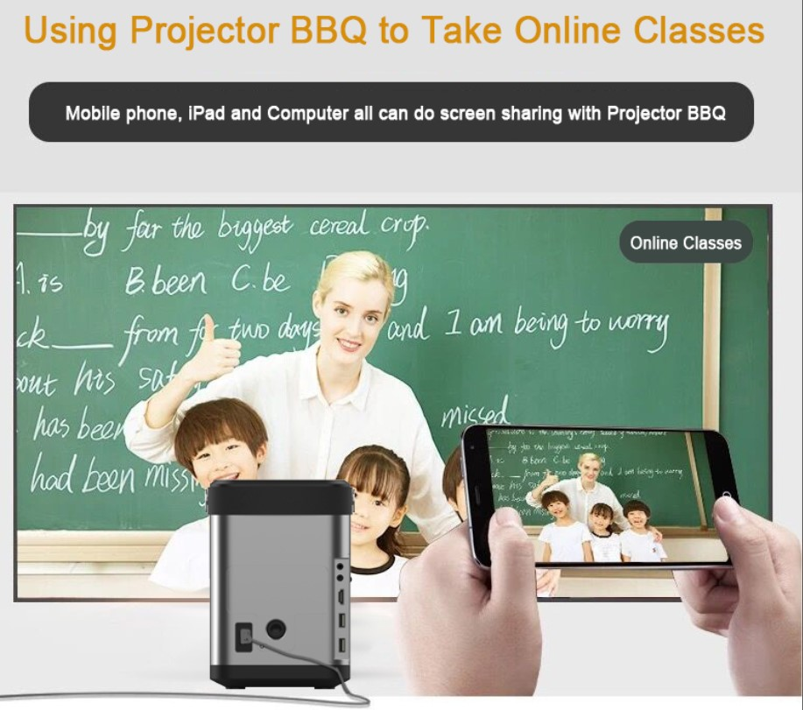
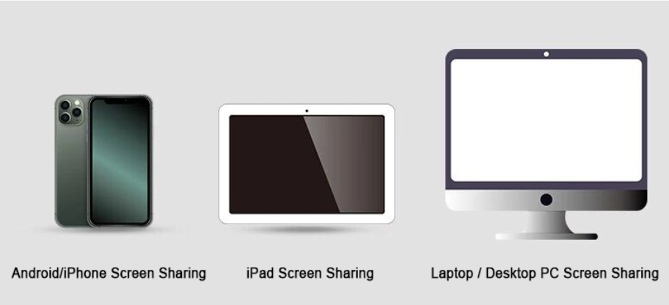
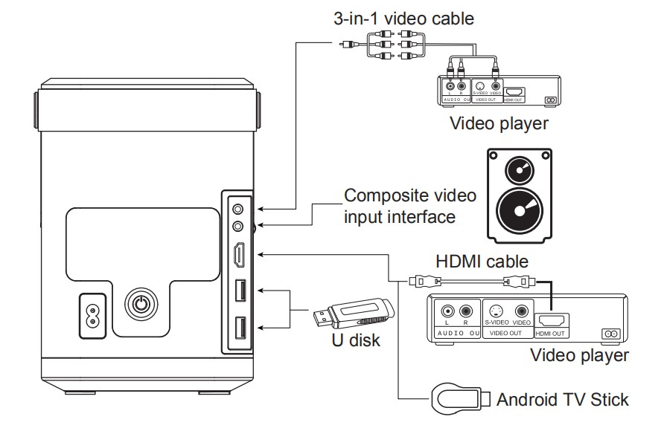
Miracast, AirPlay, all kinds of inputs, make it versatile device.

Slide 7
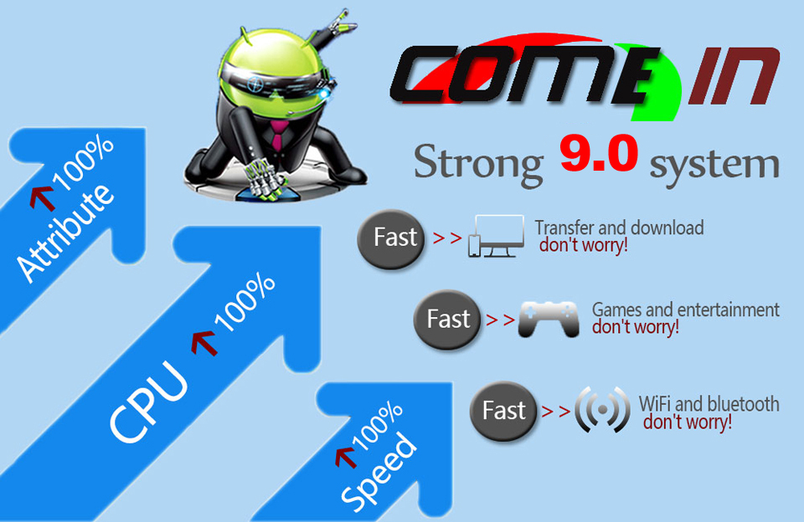
Android 9.0 OS, Original Google ATV OS GOOGLE PLAY, YOUTUBE, NETFLIX…………
Ever Strong Software and Hardware
Quad Core CPU@A55, 100% faster than ever;
2G RAM + 32G ROM
Android 9.0
Android TV OS especially for big screen by Google
All 4K videos, even 8K videos can be played

Slide 8
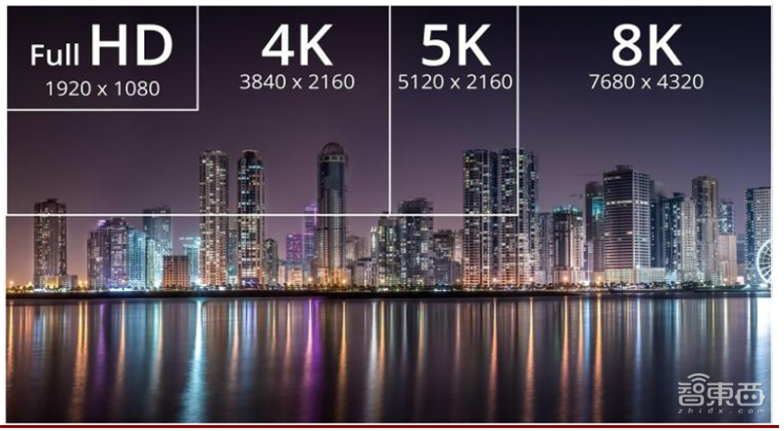
All 4K Videos, Even 8K Videos Can be Played 1080P Full HD,4K@H.264,4K@H.265, 8K@24FPS Supported Enjoying the incredible details when watching 4K 8K movies

Slide 9
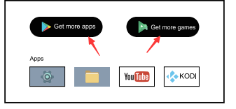
Android TV Launcher (Orginal Copy) Google Play, Youtube, Netflix,KODI, Dolby, AC3, DTS.
This model has a convenient and intelligent system.
The World First to adopt Google TV (Anroid TV/ATV)in the LCD projection industry, as Samsung, Sony, ROKU do in their TV systems. The most popular online video APP is on the homepage, and all the traditional sources are easy to access.
This model is intelligent enough to be quietly simple in your life.

Slide 10
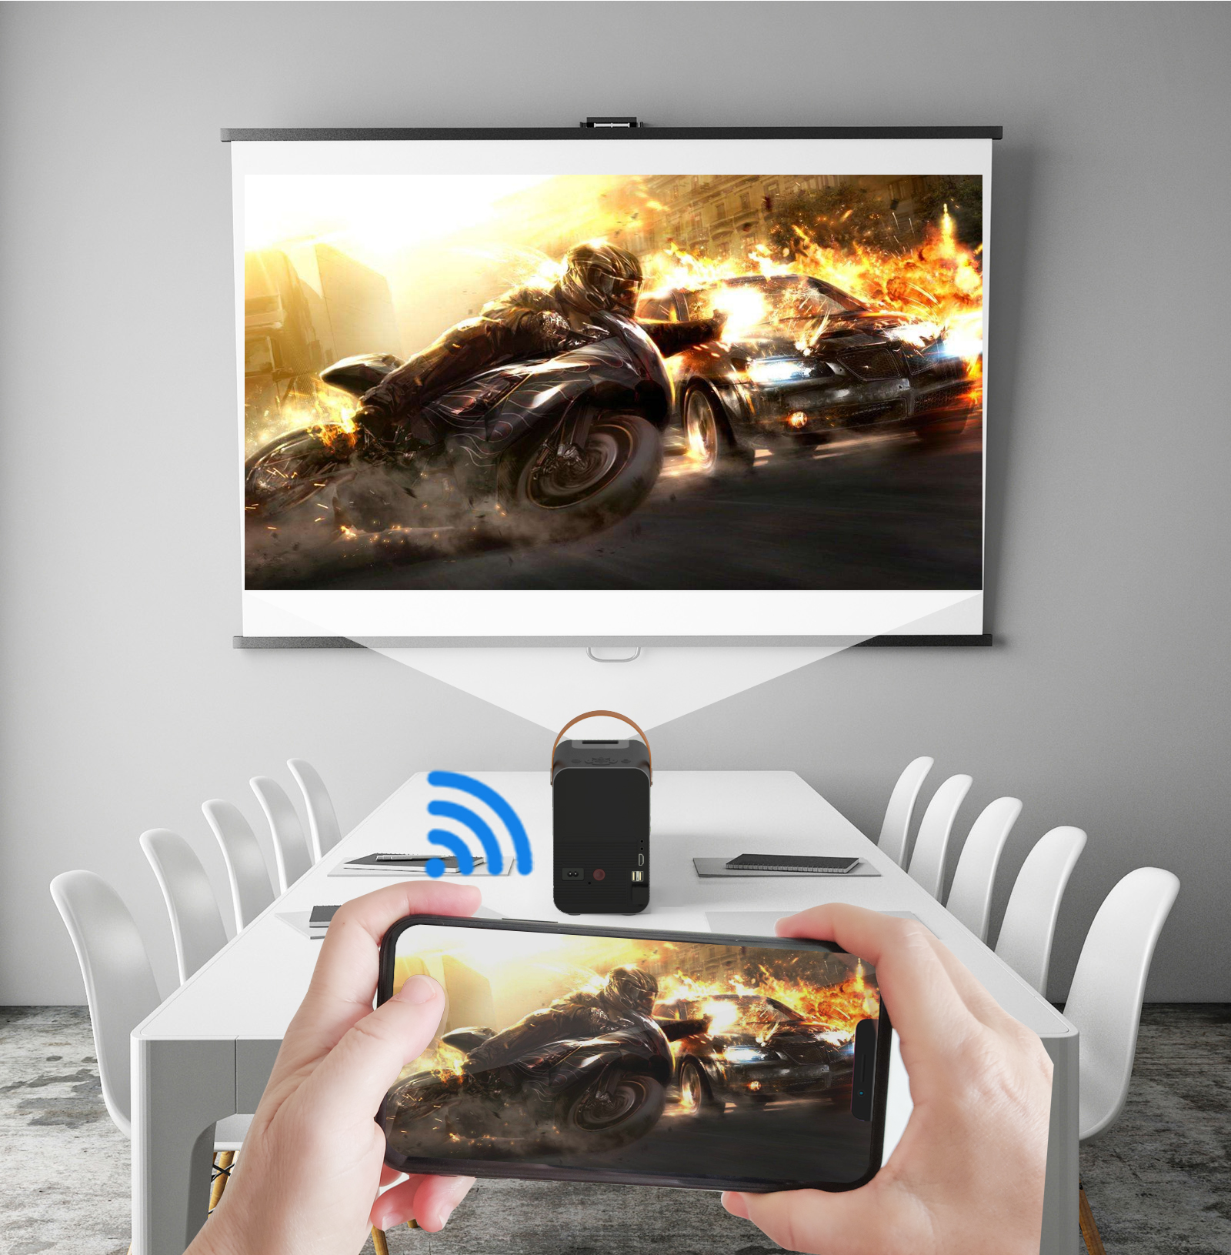
Sync With Mobile via AirPlay and Miracast

Slide 11
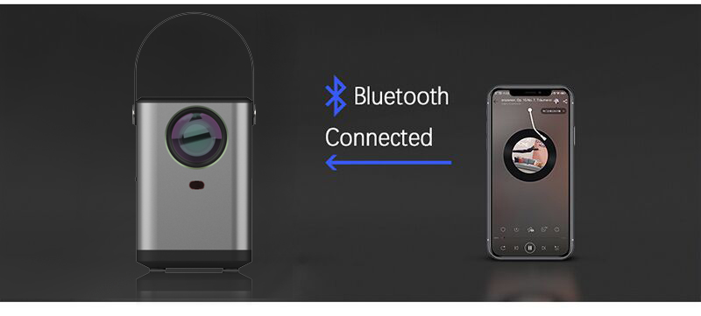
Most of time, you may just need a Bluetooth Speaker
One Touch, to make it a Bluetooth Speaker
Enjoy your music on your mobile phone
Super sound system with 300 cc Sound Chamer and DSP chipset for Bass and tremble tuning.

Slide 12
Send your mobile's online video to Projector BBQ4's screen via DLNA

Slide 13
Rich Interface for Universal Connection Ports
HDMI*1
USB*2
AV-in*1
3.5mm Audio-out*1
USB-Ethernet-Adaptor supported;
Bluetooth Audio in+Audio Out;
Compatible with Mobile,DVD Player,Laptop,Desktop PC,X-box,
Set Top Box, PS3,etc.
Along with Android, all the languages included

Slide 14
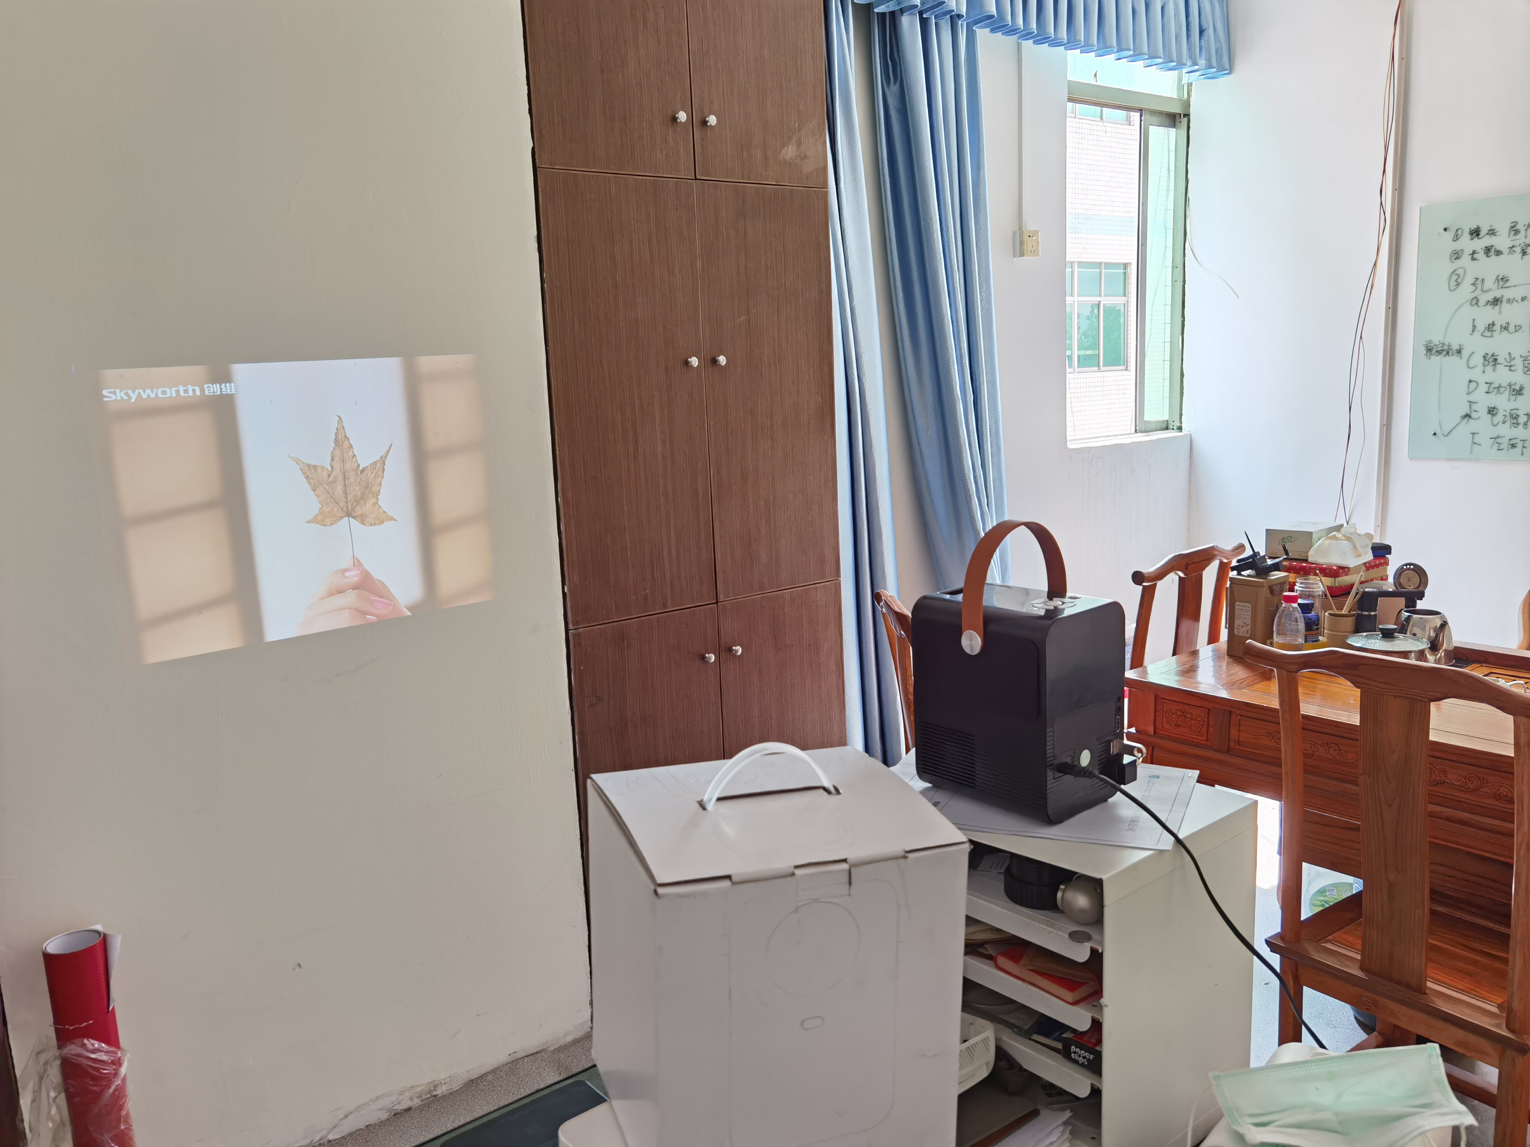
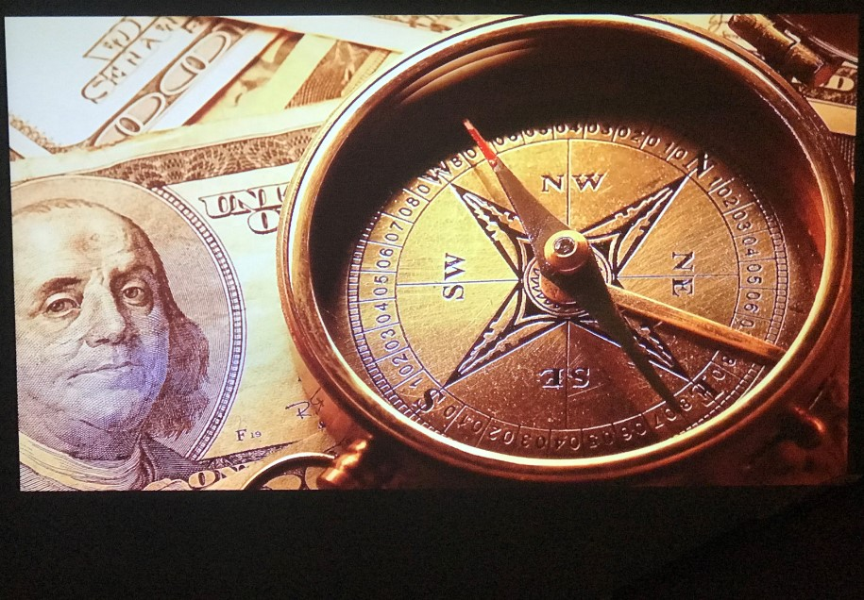
Brightness is More than 160ANSI lumens, equal to 3000Lumens & Native Resolution: 1280x720P
Excellent watching experience with 100% brighter and sharper images.
Photo taken in sunshine room
F1.9 1/100 S ISO 80
Photo taken in dark room
F1.9 1/100 S ISO 80

Slide 15
Contrast ratio: 2000:1 makes HD Image

Slide 16
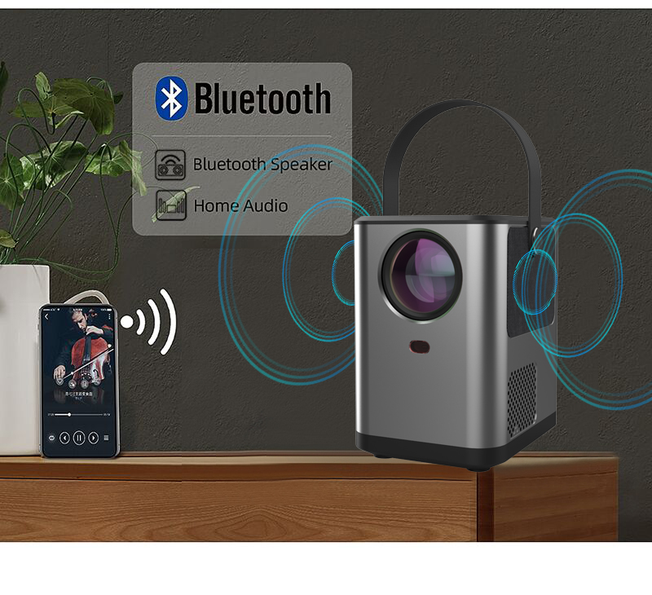
Built-in 5W×2 Stereo Speakers
Super sound system with 300 cc Sound Chamer and high-end DSP chipset for Bass and tremble tuning.

Slide 17
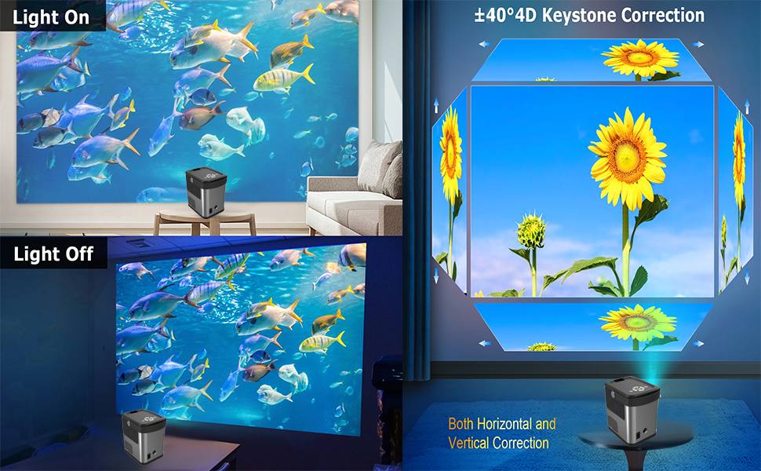
4D Horizontal+Vertical Digital Keystone Correction Any Place, Any Projection
Ever Best digital Keystone Correction

Slide 18
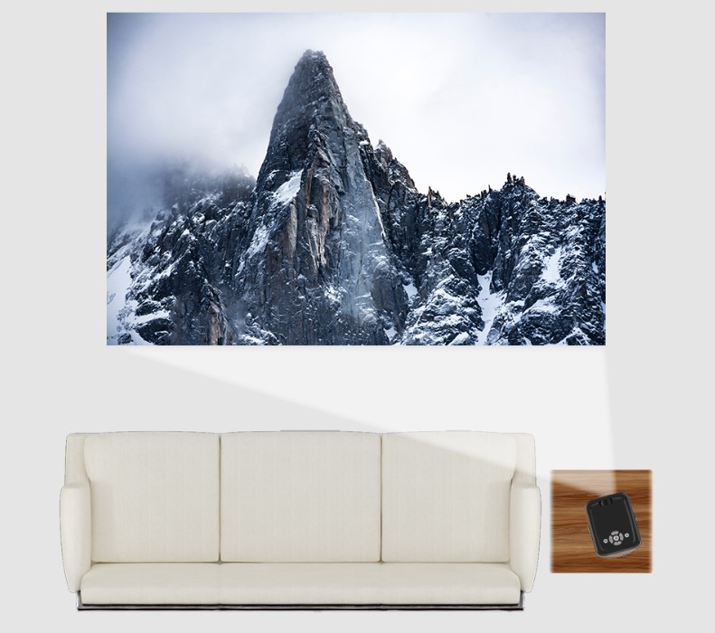
4D Horizontal+Vertical Digital Keystone Correction Support Side Projection
Any Place Easy Projection

Slide 19
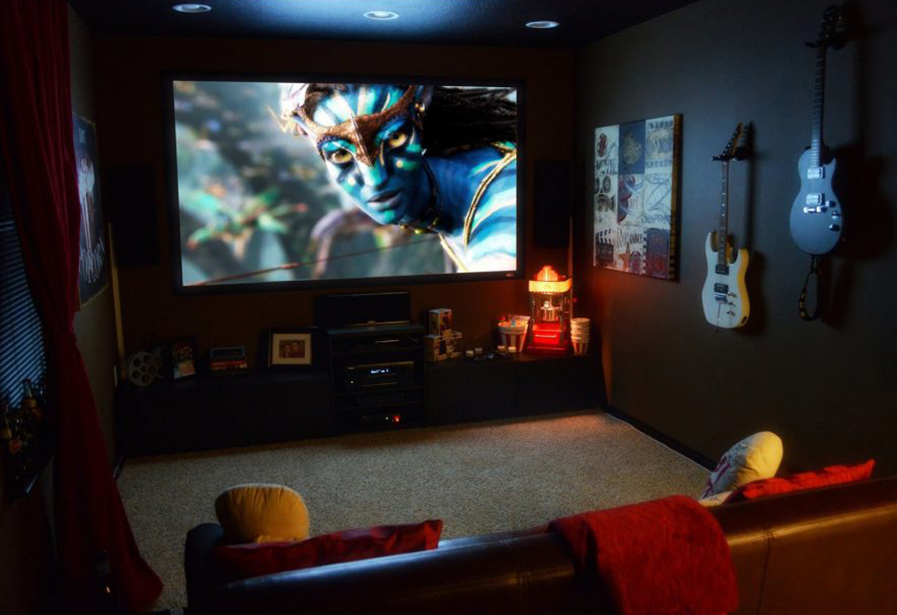
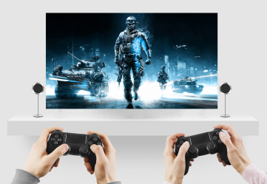
Compact Design Meets Different Use
Outdoor
Movie
Home
Movie
FUN
ANYWHERE
Video
Games
Music Party

Slide 20
Being Unique, Being Smart and Simple
With its built-in Android9.0 operating system, this model is smart projector.
To access internet via WiFi or Ethernet , to play online videos, to connect smart mobile devices with AirPlay and Miracast, this projector is outstanding in the whole projection industry.
With the help of a smart WiFi & Bluetooth technology, and convenient connection to smart devices, this projector can make your home cinema life more convenient and comfortable.
Moreover, the price is also economical.

Slide 21
Learn More when comparing with others
Android 6.0 | Android 9.0
1G DDR3 | 2G DDR4
Basic Android OS | Google Android TV OS for big screen
No Google Play, | With Google play and all the Apps
A53 CPU | A55 CPU with 120% faster
4K @H.265, Less than 30FPS | 4K@H.265, H.264, up to 60 FPS
Dolby | Dolby, AC3, DTS
with compatible problem with many Apps | smooth for all Apps
small speakers, Only amplifier | big speaker with 300 cc Chamber with DSP
No optical engine inside | Optical Engine Inside
lower brightness | much higher Brightness with super design
1 or 2 small fans (4020, or 5015) | 2 big fans (6028+7025) for lower noise
53mm Lens | 68mm Lens

Slide 22
Coparing with other projector's image
Outdoor
Movie
Outdoor
Movie
Projector BBQ4r
Movie
Other Cheap Projectorr
Movie

Slide 23
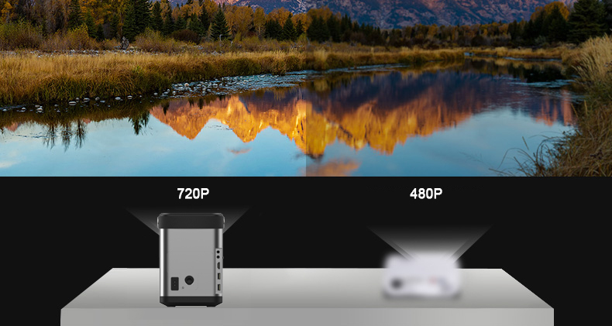
The diffrence between 720P and 480P Projector
High definition image is preferred.

Slide 24
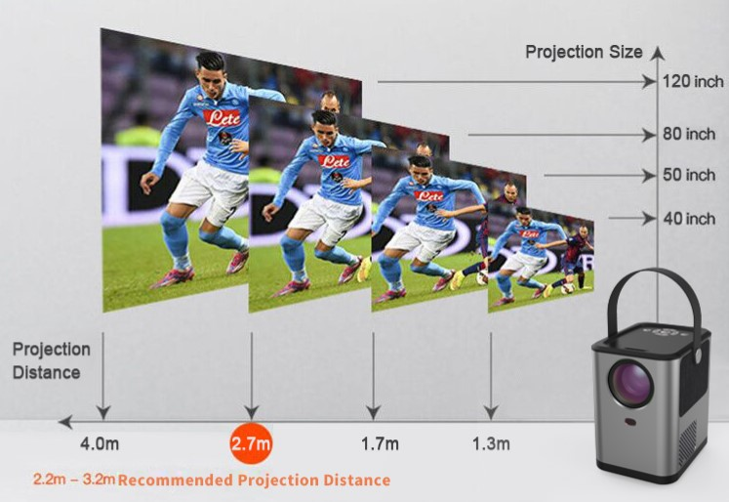
Projection Screen @ Projection Distance

Slide 25
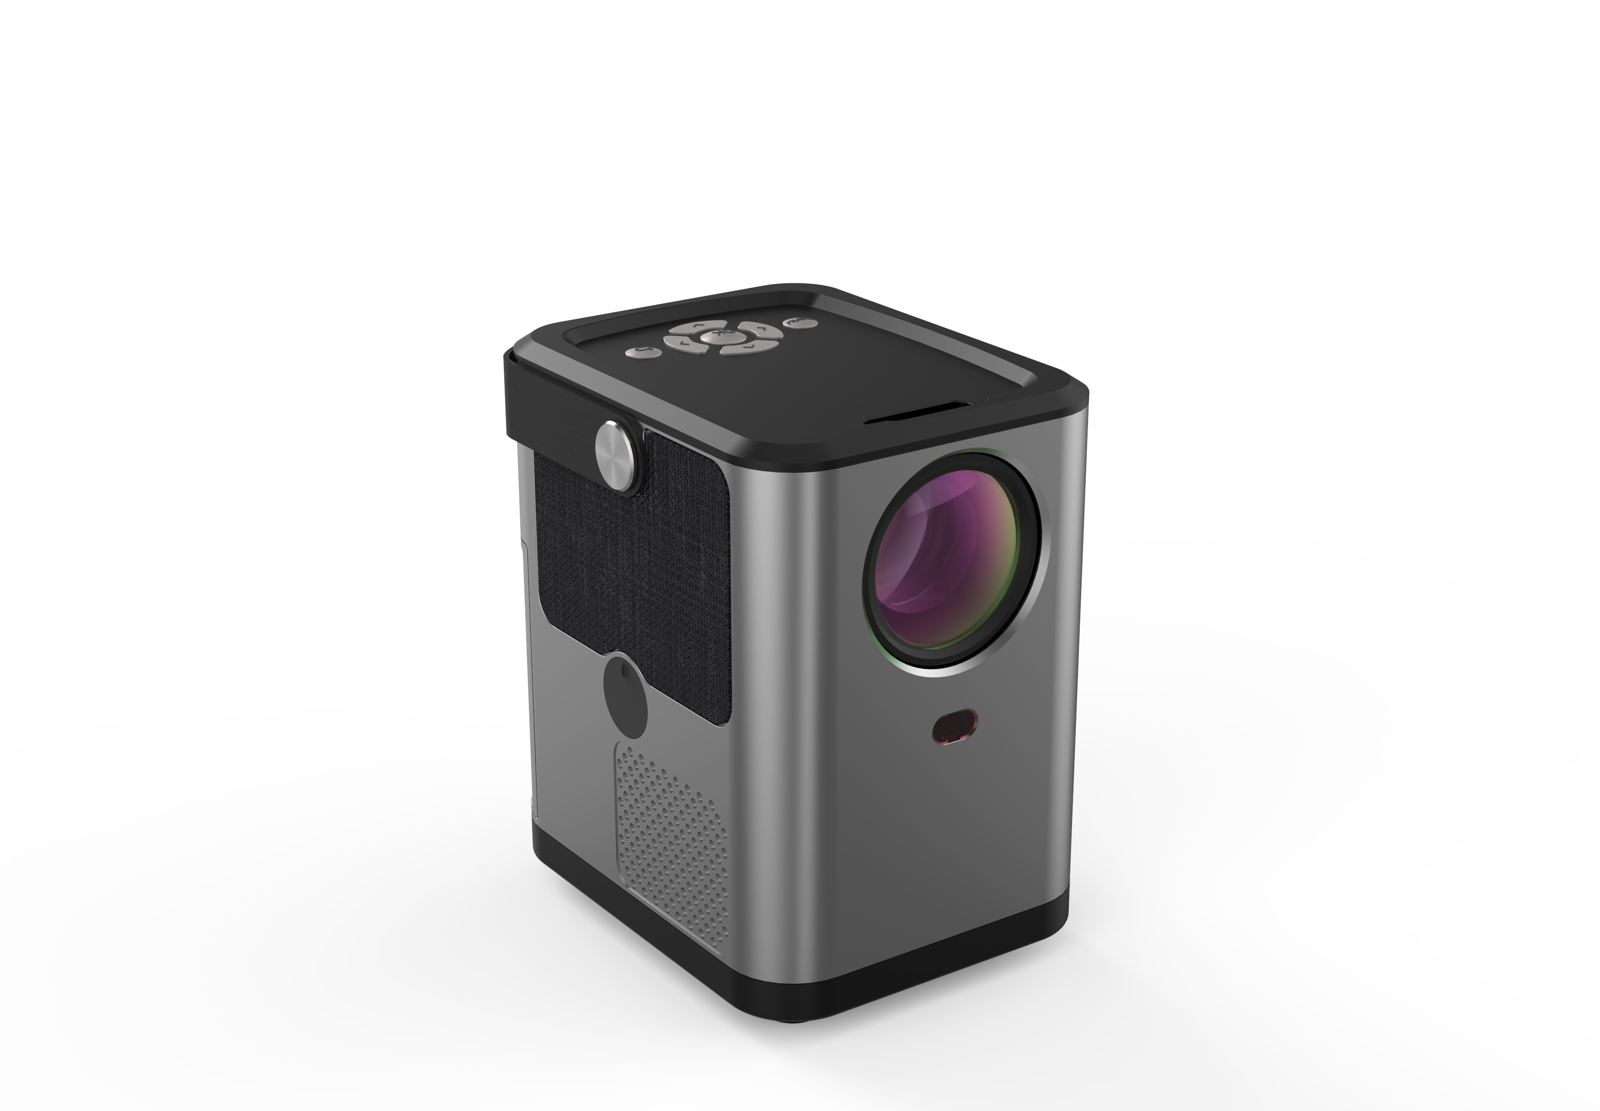
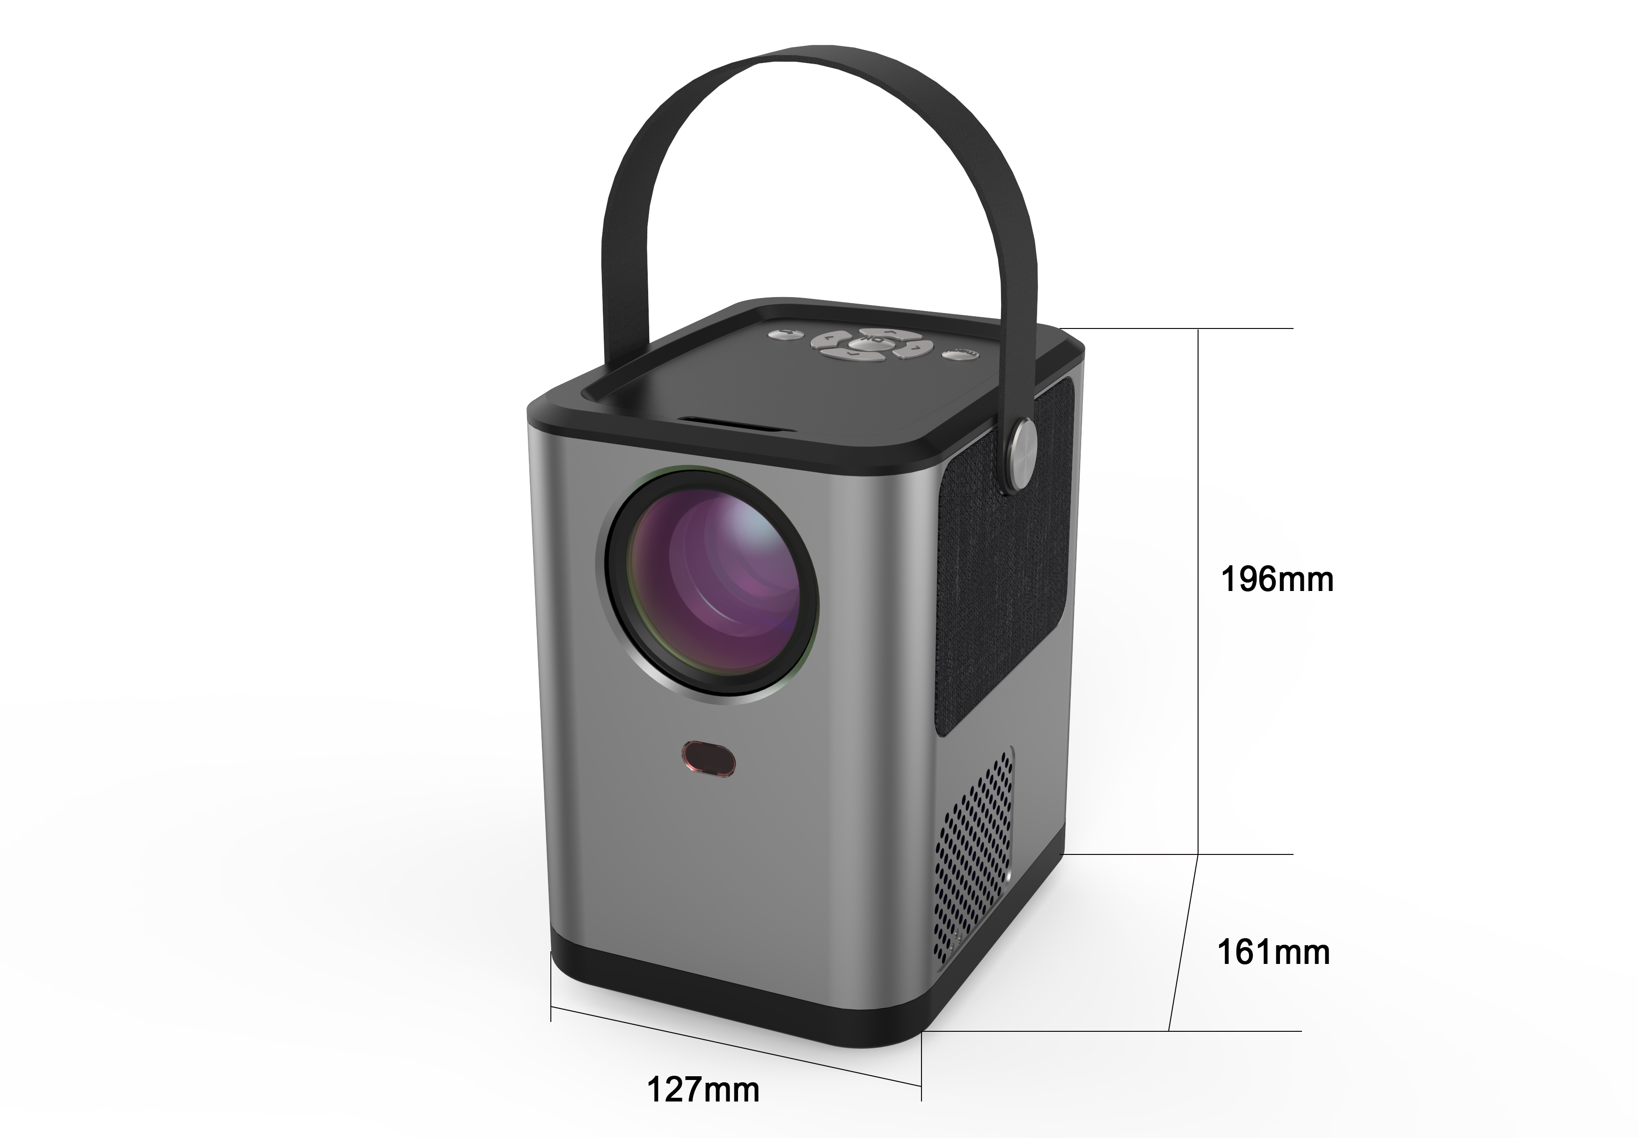
Projector BBQ for offline distribution only

Slide 26
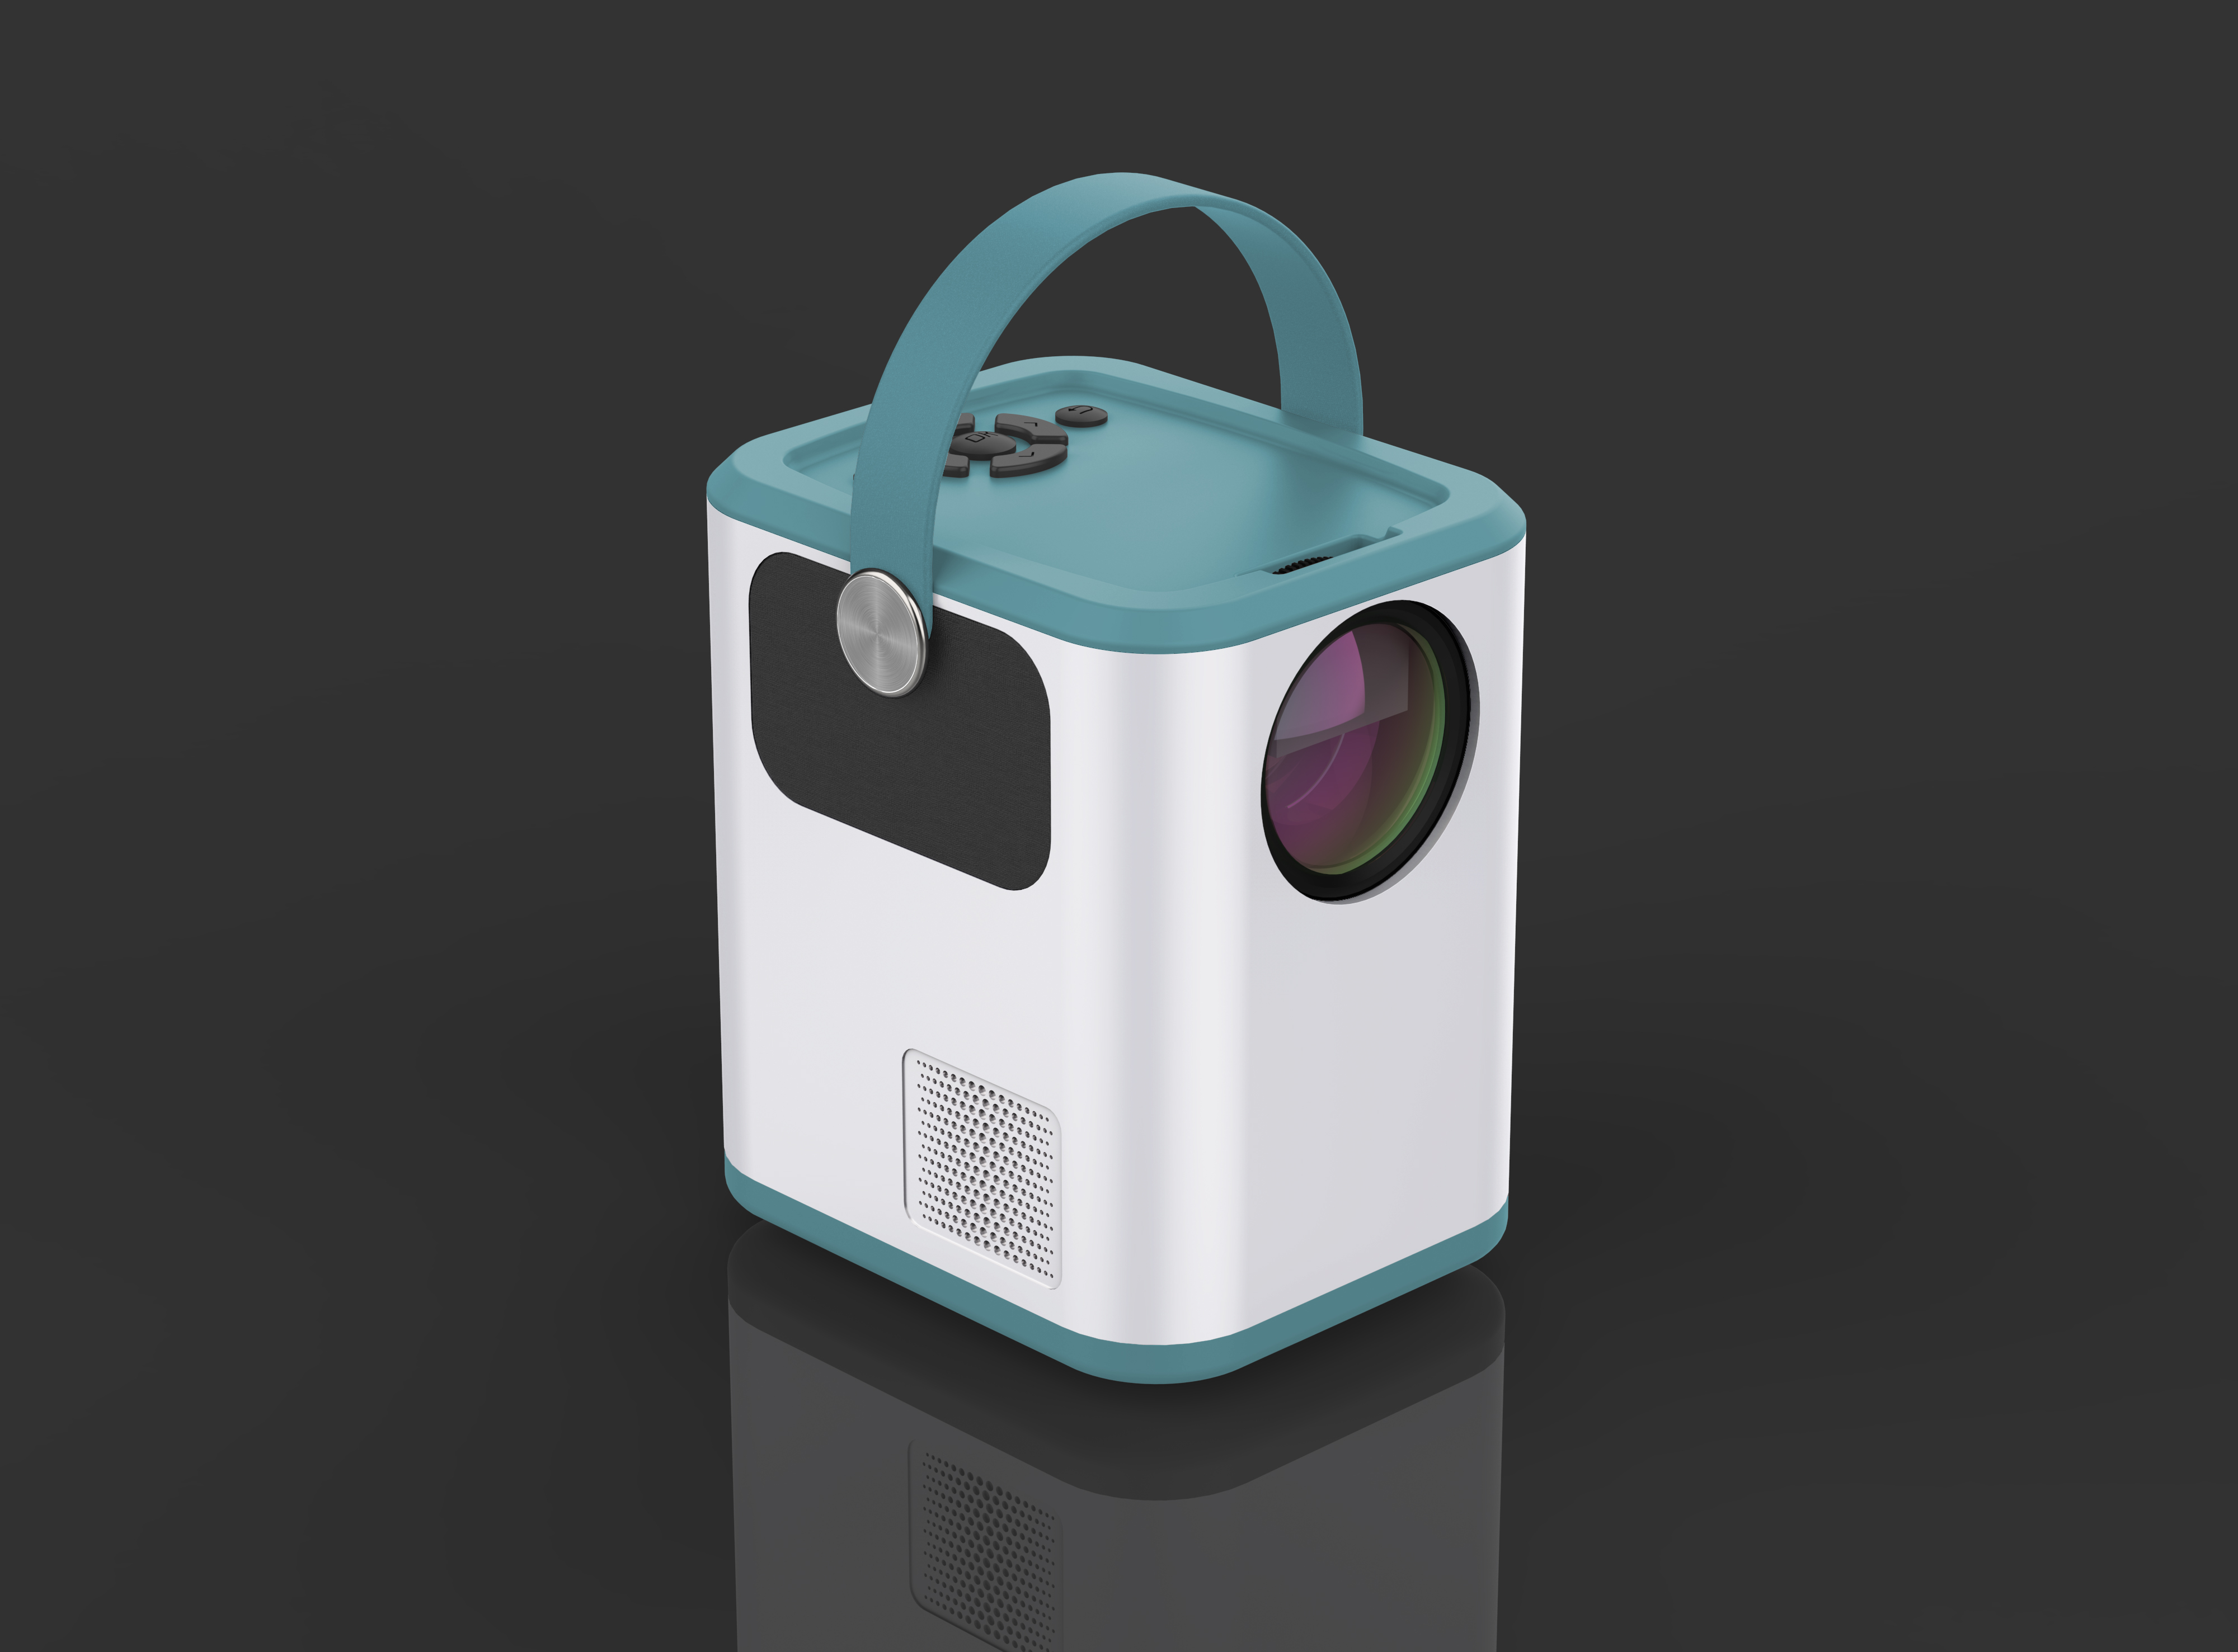
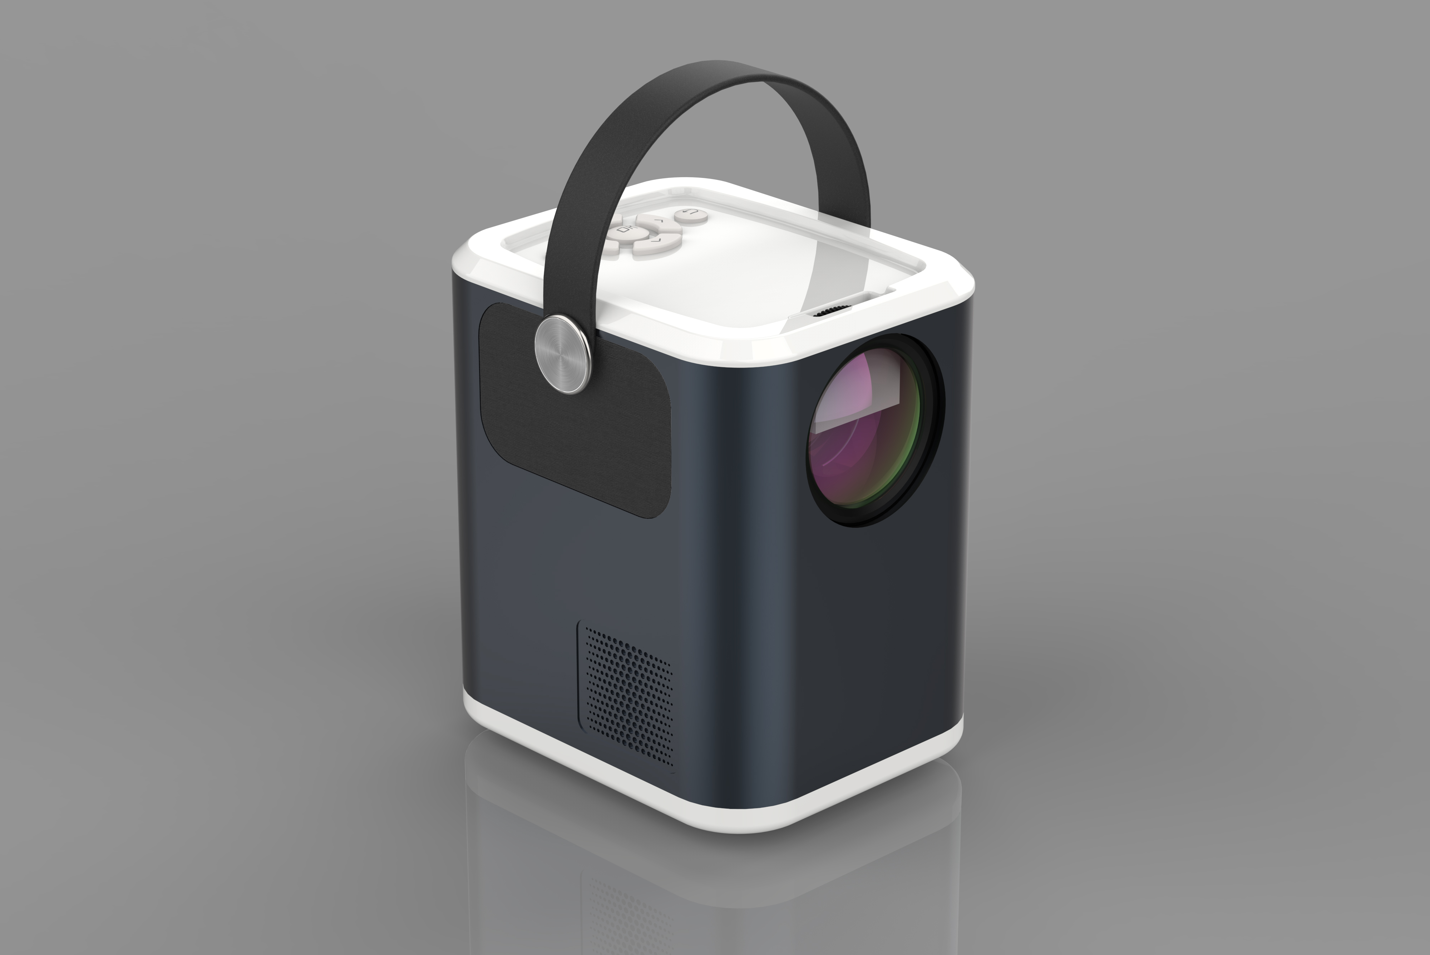
Projector BBQ for offline distribution only

Slide 27
Projector BBC for both online&offline distribution 3 Versions and 4 Colors are available BBC2 (Basic Version) BBC3 (Miracast Version) BBC4 (Andriod9.0 Version)

Slide 28
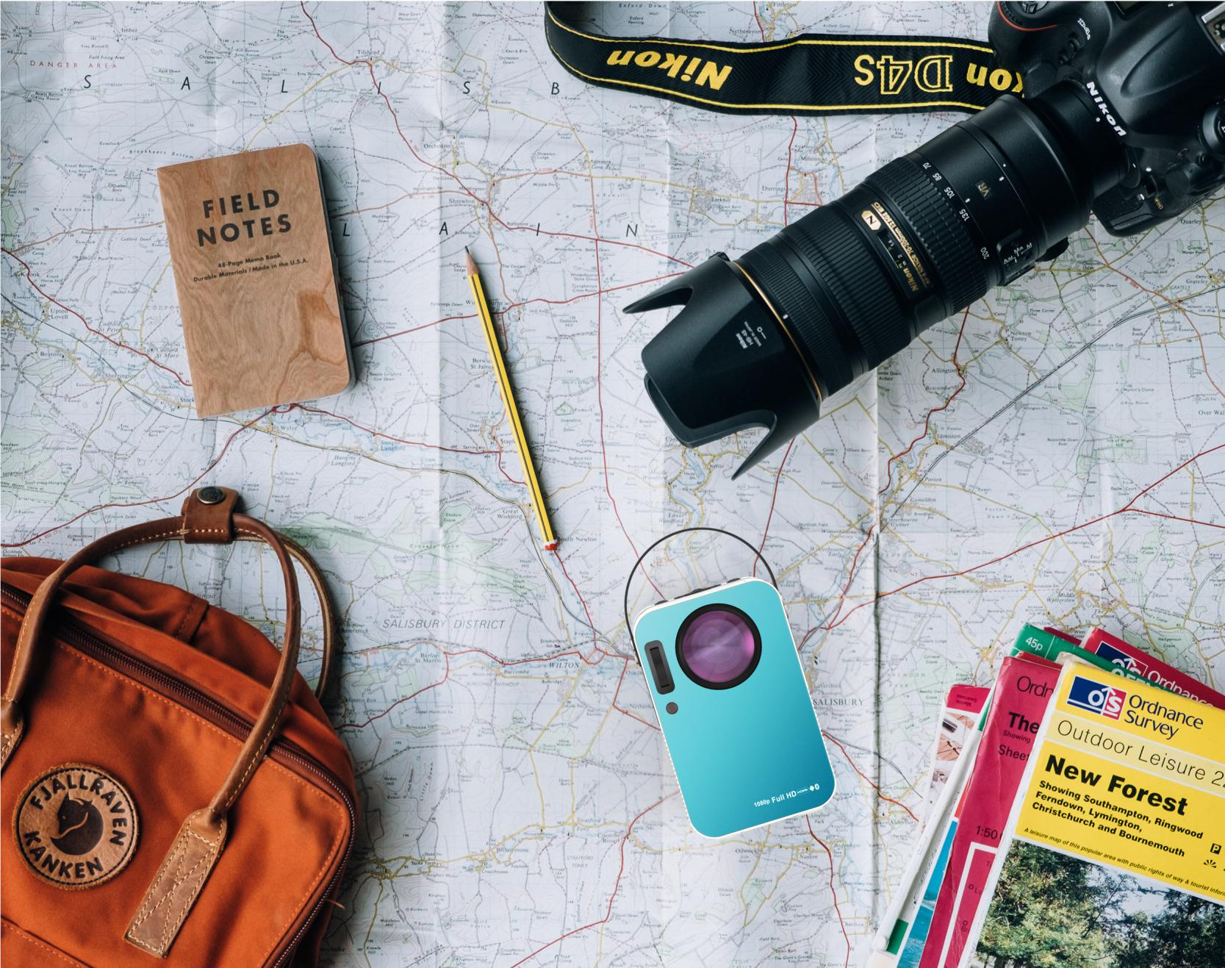
THANK YOU

