Slide 1
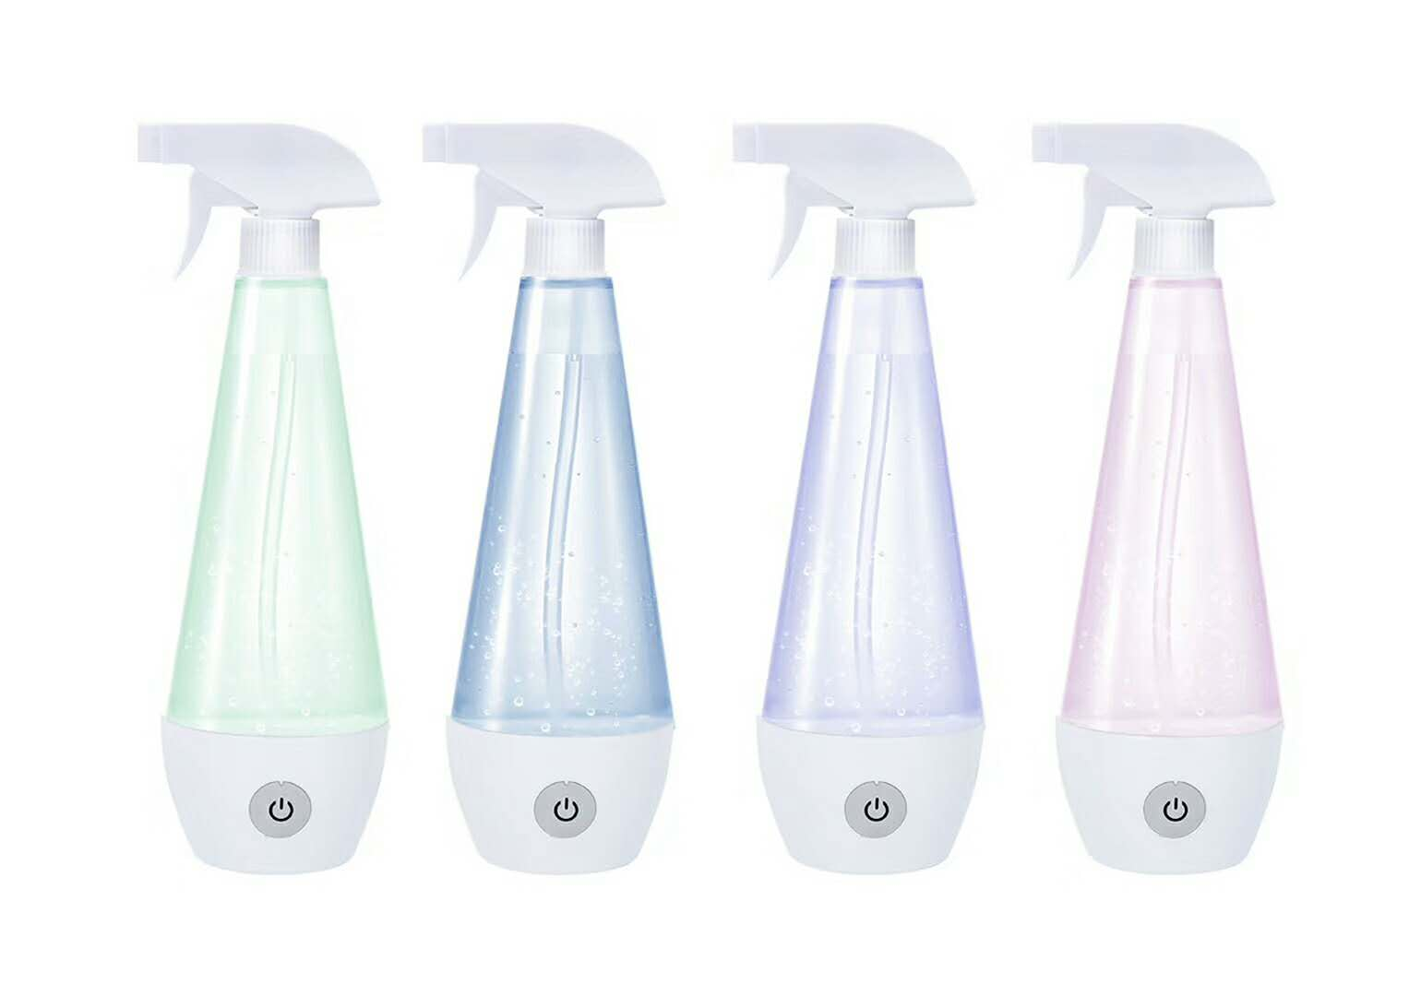
Disinfection Maker
Supplier Information:
1. XULEI .
2. 13726318020 407186847@QQ.COM
Product Specification:
Working time: 6 minutes
Voltage: AC 220V/5V—1A
Power: 5W
Capacity: 250ML
Product size: 245X90mm
Packaging size: 115X75X270mm
FOB Shunde: USD 12.00
MOQ: 2000PCS

Slide 2
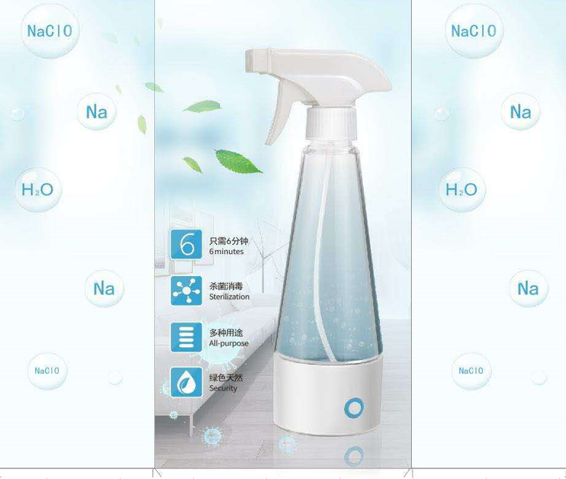
Selling Point:
Supplier Information:
Disinfection reach 99.9%
6 minutes only to generate disinfection liquid.
Multi-purpose can be applied.
Natural and environmental protection .
The disinfection liquid can keep one month with sealed bottle cap and the failure rate is controlled from 10%-25% .
Portable and easy to be used by everyone.
Save money, no need to buy expensive disinfection products from now on.

Slide 3
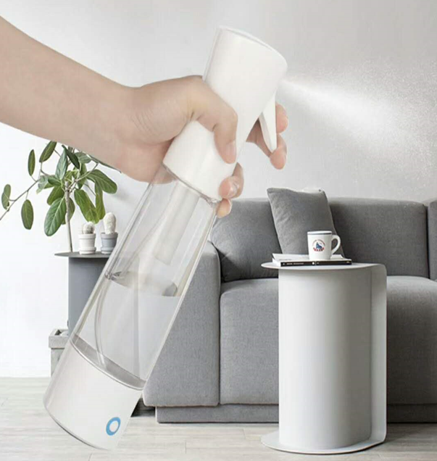
Selling Point:
Supplier Information:
Product function:
It can remove stains, oil stains, fishy, deodorant, mildew and so on.
2. Range of use:
Kitchen cleaning
Furniture surface
Air disinfection
Wound disinfection
Children's toys
Floor
Carpet
pet supplies disinfection and so on.

Slide 4
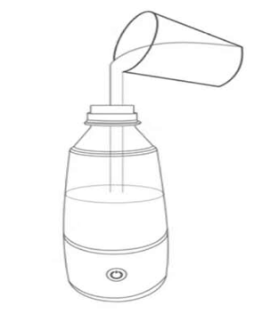
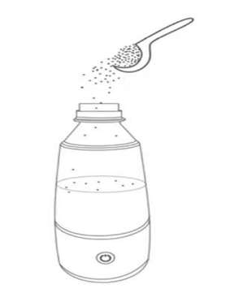
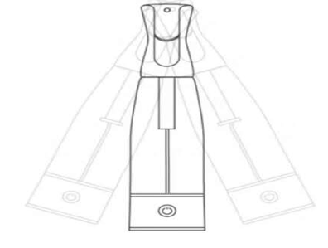
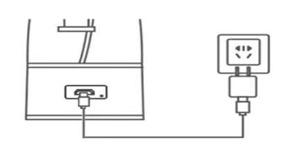
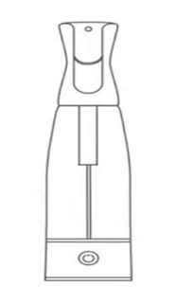
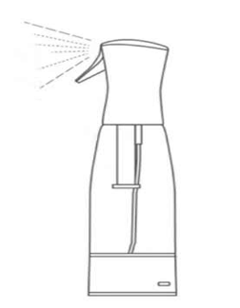
How to use it
Step 1: add water
Step 2: add a spoon of salt(2g)
Step 3: Shake evenly
Step 4: Connect to power
Step 5: Switch on
Step 6: Ready to use

