Slide 1
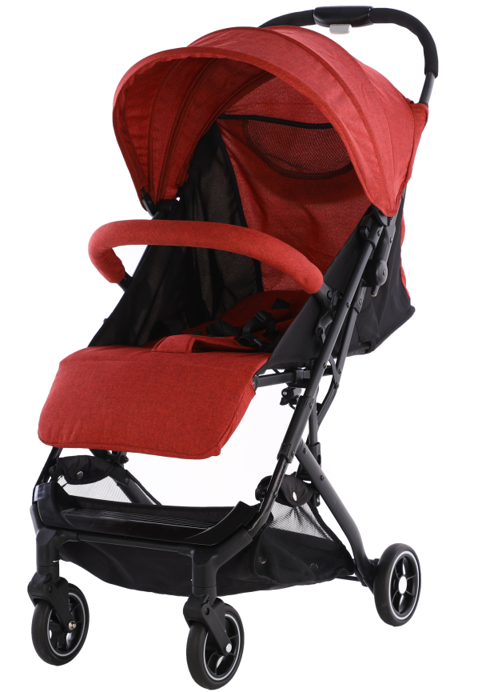
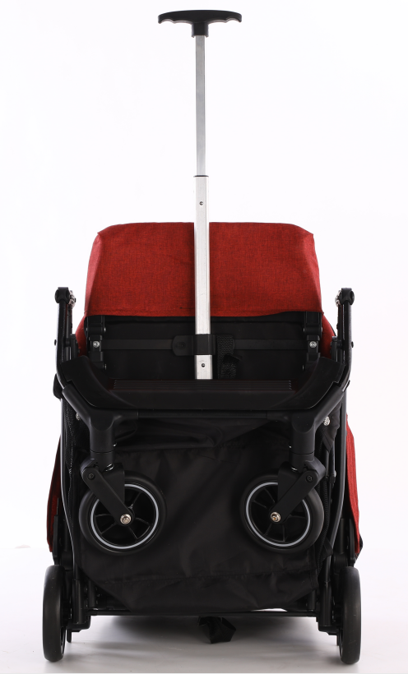
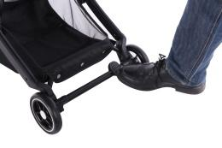
YH-N002F
Foldable frame
structure
3-position Foldable canopy
Detachable
bumper bar
5-point harness
Multi-position
adjustable backrest
Adjustable legrest
Front wheel
● Detachable
● Orientated
● Suspension
● 5” wheels
One step brake
Package: 1 pc/ctn;
Unfold size: 610×450×1030mm
Carton size: 455×225×550mm
N.W.: 6.5kgs
G.W.: 7.5kgs
Q’TY: 20GP: 1250PCS

